Slide 1
ELECTRONIC ROSTER CASE DEFINING ENABLED PARTIES
201.225 ELECTRONIC ROSTER AUTHORIZATION.
§Subdivision 1.Authority.
A county, municipality, or school district may use electronic rosters for any election. In a county, municipality, or school district that uses electronic rosters, the head elections official may designate that some or all of the precincts use electronic rosters.
--------------------------------------------------------------------------------------
Enables poll pad decision to use by county, municipality or school district
Enables subsequent/subordinate delegation subject to governing body decision

Slide 2
DEFINING ENABLED PARTIES
MS 201.225 Subd. 6.Reporting; certification.
(a) A county, municipality, or school district that intends to use electronic rosters in an upcoming election must notify the Office of the Secretary of State at least 90 days before the first election in which the county, municipality, or school district intends to use electronic rosters. The notification must specify whether all precincts will use electronic rosters, and if not, specify which precincts will be using electronic rosters. The notification is valid for all subsequent elections, unless revoked by the county, municipality, or school district. If precincts within a county, municipality, or school district that were not included in the initial notification intend to use electronic rosters, a new notification must be submitted.
(b) The county, municipality, or school district that intends to use electronic rosters must certify to the Office of the Secretary of State at least 30 days before the election that the electronic rosters meet all of the requirements in this section.
------------------------------------------------------------------------------------------------
County, municipality or school district are equally enabled to use poll pads
If-Then=If intends to use, then certain reporting requirements
County, municipality or school district may revoke use within their jurisdiction

Slide 3
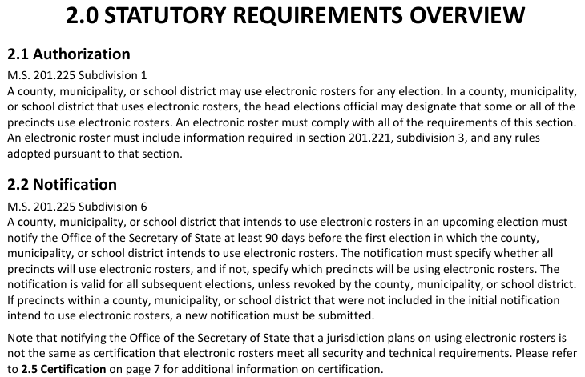
Source: MN SOS 2016 Electronic Roster Guide
2016 Electronic Roster Guide (state.mn.us)

Slide 4
DELEGATION OPTIONS & APPROVALS NEEDED
MS 201.221 Subd. 4.County rules.
The county auditor of each county may adopt rules that delegate to the secretary of state or municipal officials in that county the duties assigned to county auditors by this chapter. Delegation of duties to the secretary of state requires the approval of the secretary of state. Delegation to a municipal official requires the approval of the governing body of the municipality. Delegation by the county auditor of the duty to accept registrations does not relieve the county auditor of the duty to accept registrations. Each delegation agreement must include a plan to allocate the costs of the duties to be delegated.
-------------------------------------------------------------------------------------
Under County Rules, County Auditor may delegate duties to municipal officials.
Such delegation is subject to municipal approval; County may not mandate use of electronic roster system (poll pads) in a municipality without their approval, thus the need for agreement

Slide 5
STATUS OF 2018 POLL PAD AGREEMENTS
21 Agreements between Anoka County and municipalities exist
They are all the same
They all have two parties, either of which may terminate the agreement effective after a 7 day written notice
Anoka County signatures were all by County Administrator Jerry Soma and Assistant County Attorney Jason Stover
Municipal signatures included 3 elected officials, 8 administrators or clerks and 10 undecipherable names or positions.

Slide 6
POLL PAD AGREEMENT APPROVAL STATUS ANOKA COUNTY
There is no evidence the Anoka County Board voted to approve any of these agreements*
No publicly posted meeting agenda
No publicly posted staff report
No publicly posted agreement documents
No public discussion held
No public official vote of approval
No publicly posted meeting minutes
Question: Is use of electronic rosters system legally approved in Anoka County?
Question: Does Anoka County have any legal standing to enforce agreements?
*A Public Data Practices Act Information Request of County only produced action to purchase electronic roster system (poll pads), no action on agreements

Slide 7
POLL PAD AGREEMENT APPROVAL STATUS 21 MUNICIPALITIES
There is evidence that City of Oak Grove approved on June 28, 2018
But no evidence yet found that the other 20 municipalities voted approval
No publicly posted meeting agenda
No publicly posted staff report
No publicly posted agreement documents
No public discussion held
No public official vote of approval
No publicly posted meeting minutes
Do these agreements have any legal standing if not formally approved?

Slide 8
CONCLUSION & QUESTIONS
These agreements may not be legally authorized
No state statute requires the use of electronic roster system poll pads
Municipalities may terminate these agreements
Deployment of poll pads requires municipal approval
------------------------------------------------------------------------------------------
Why do these agreements exist if County may unilaterally mandate use?
Why is there a termination provision if County may unilaterally mandate use?
What decision-making methods were used in other counties creating a mixture of precincts use fully, partially or not at all?

